Slide 1


UNIVERSITY OF MUMBAI
IBSAR College of Management and Studies
(Affiliated to University Of Mumbai)
2013 – 2014
Project Report On
DISH IS WISH
(Online Restaurant and Recipe Search)
Project work submitted in partial fulfillment of the requirements for the award of the degree of
MCA (Master of Computer Application)
SUBMITTED BY: JAGRUTI D. PATIL,
SHWETA DESAI,
SHEETAL TIWARI.
PROJECT GUIDE: MR.MANIKANT ROY

Slide 2
INDEX
Company profile
Team Members
Introduction
Objectives
Hardware & Software Specification
Agile methodology
Advantages
Dataflow Diagram
E-R Diagram
UML Diagram
Database Table Structure
Screen shots
Admin screen shots

Slide 3
Company Profile
Name
Vedant IT Academy (VIA).
Time duration
Six Months.
Location
Thane(E).
Development areas
HTML5, CSS3, SEO, Magento, yii Framework, WP.
INDEX

Slide 4
TEAM Members
Team Members Name Division Roles View INDIVIDUAL PROFILE
Jagruti Digambar Patil. Div-A developer View
Shweta Baburao Desai. Div-A Developer View
Sheetal Shantaram Tiwari. Div-A tester View
INDEX

Slide 5
Jagruti Digambar Patil
project Technology used Roles
www.dishiswish.com. Php,ajax,html developer
Krish products(e-commerce site). Magento framework Everything
Electionadda(facebook App). Facebook api,php html Everything
Go Back

Slide 6
Shweta Baburao Desai
project Technology used Roles
www.pethekul.org php,css,html designer
www.radhasaitutorials.com yii framework development
6
www.dishiswish.com
Go Back

Slide 7
Sheetal Shantaram tiwari
project Technology used Roles
www.itvedant.com. Wordpress framework developer
www.basutok.com wordpress framework designer
www.dishiswish.com
7
www.dishiswish.com
7
Go Back

Slide 8
Introduction
Dishiswish.com
is founded to support the market in growing needs of end users for the Quality Restaurants & Kitchen Products Information
INDEX

Slide 9
Objective
To provide an online platform which gives list for all hotels and recipies in all the regions online.
To Give proper Information and Services that everyone provides
INDEX

Slide 10
Hardware & Software Specification
Hardware Specification
intel core i3 or higher version
2GM RAM or more
15.6 HD display (for better view)
Software Specification
Frontend : PHP, HTML, CSS
Backend : Mysql
INDEX

Slide 11
Software development methodology
Agile development model
Type of Incremental model.
Software is developed in incremental, rapid cycles.
Results in small incremental releases with each release building on previous functionality.
Each release is thoroughly tested
Software quality is maintained.
It is used for time critical applications.
Extreme Programming (XP) is currently one of the most well known agile development life cycle model.
INDEX

Slide 12
Advantages
Nowadays, internet has reached almost to everywhere.
So it is necessary to utilize the available resources efficiently and for the benefits of all the users.
We should able to get all the things in one look .
There will be the city wise listing of all hotels and kitchen compass with their contact numbers and address.
Facility to add into the wish list.
Will display all brands and their products .
So that users will get all information at once anywhere so that it saves time.
INDEX

Slide 13
Data flow Diagrams
A data flow diagram (DFD) is a graphical representation of the "flow" of data through an information system, modeling its process aspects.
A DFD shows what kind of information will be input to and output from the system, where the data will come from and go to, and where the data will be stored.
DFD for dishiswish.com are as follows,
INDEX

Slide 14
Context Level Diagram
Request
Dish_Is_Wish
System
Visitor
Admin
Response
Dish_Is_Wish
INDEX

Slide 15
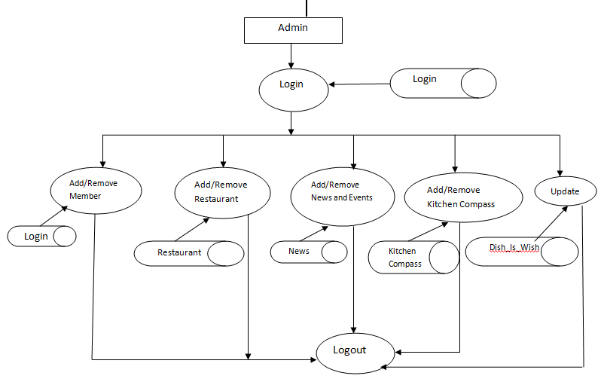
1st Level DFD : Admin
INDEX

Slide 16
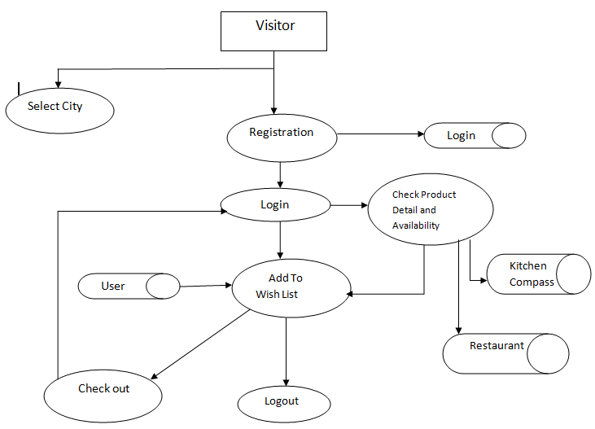
1st Level Diagram : Visitor
INDEX

Slide 17
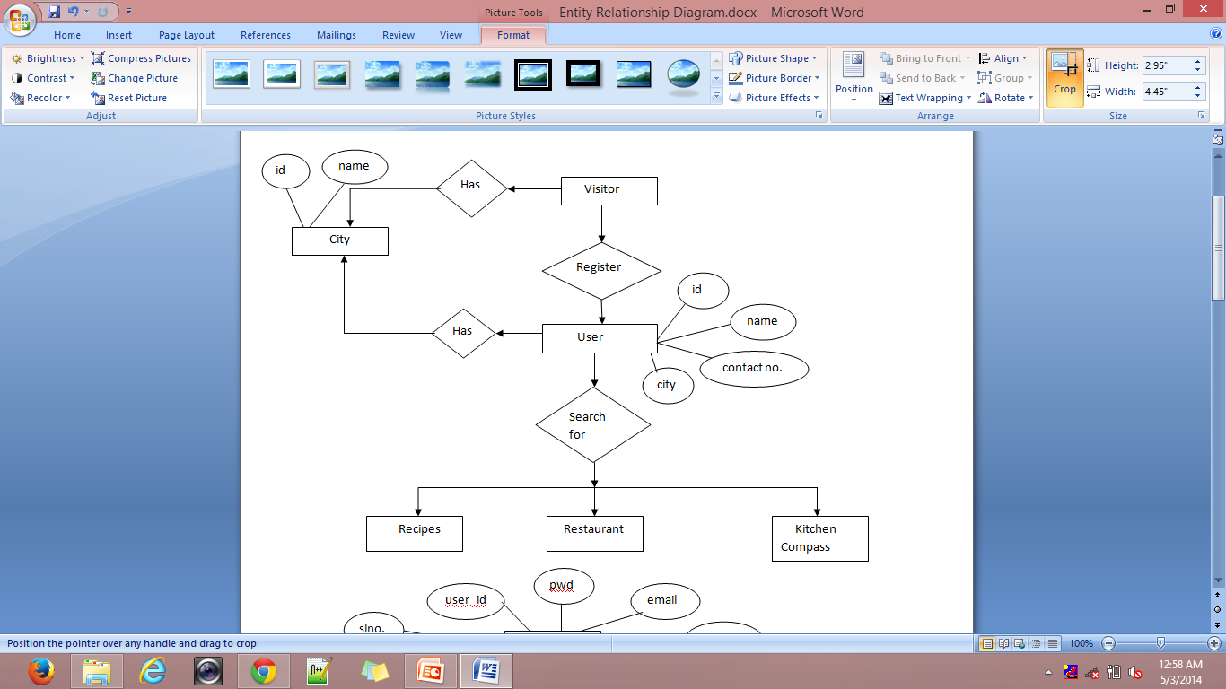
E-R Diagram : For User
INDEX

Slide 18
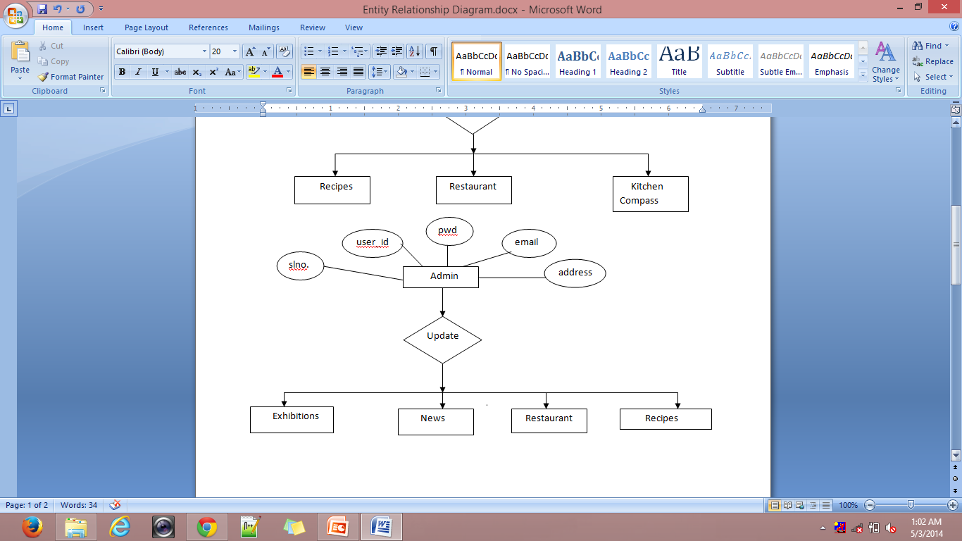
E-R Diagram : For Admin
INDEX

Slide 19
UML Diagram
The Unified Modeling Language (UML) is a general-purpose modeling language in the field of software engineering.
The basic level provides a set of graphic notation techniques to create visual models of object-oriented software-intensive systems.
Higher levels cover process-oriented views of a system.
The UML diagrams for dishiswish.com are as follows:
INDEX

Slide 20
Usecase : For Visitor
INDEX

Slide 21
Usecase : For Members
INDEX

Slide 22
Activity Diagram : For Members
INDEX

Slide 23
Activity Diagram : For Visitor
INDEX

Slide 24
Class Diagram
INDEX

Slide 25
Sequence Diagram
INDEX

Slide 26
Collaboration Diagram
INDEX

Slide 27
Component Diagram
INDEX

Slide 28
Deployment Diagram
INDEX

Slide 29
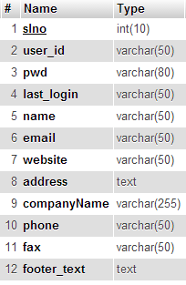
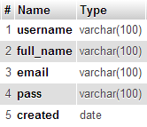
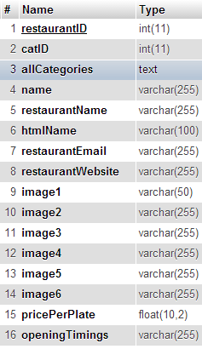
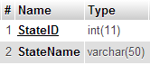
Database Table Structure
admin_details
login
restaurant
city_tbl
INDEX

Slide 30
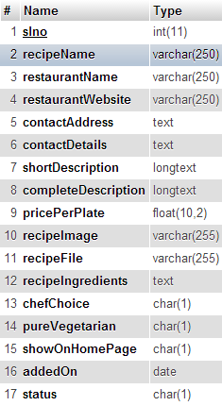
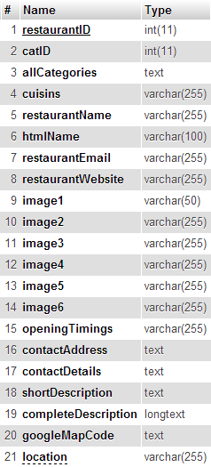
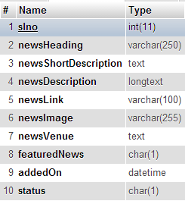
news
recipie
Kitchen_compass
INDEX

Slide 31
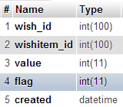
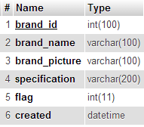
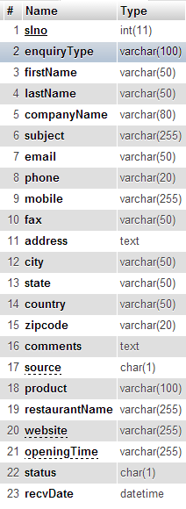
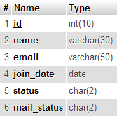
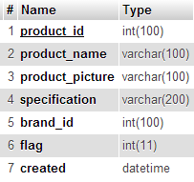
wishlist
brand
Enquiry_tb
product
Newsletter_member
INDEX

Slide 32
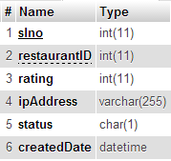
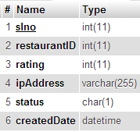
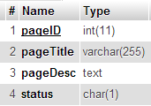
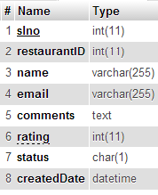
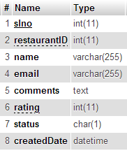
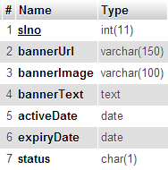
Compass_rating_tbl
Restaurant_rating_tbl
Static_pages
Restaurant_review_tbl
compass_review_tbl
Flash_banner_tbl
INDEX

Slide 33
SCREEN SHOTS
SCREEN SHOTS
OF
www.dishiswish.com
INDEX

Slide 34
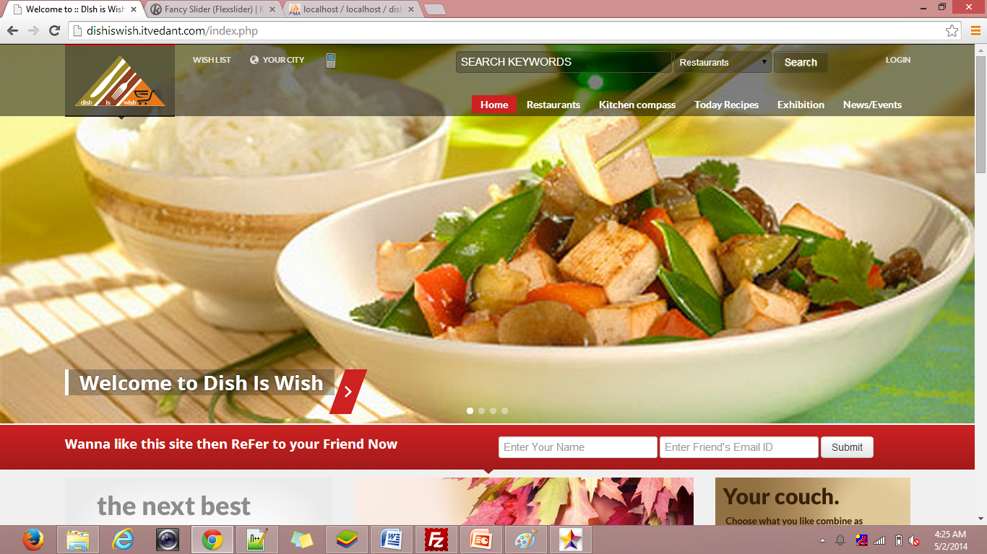
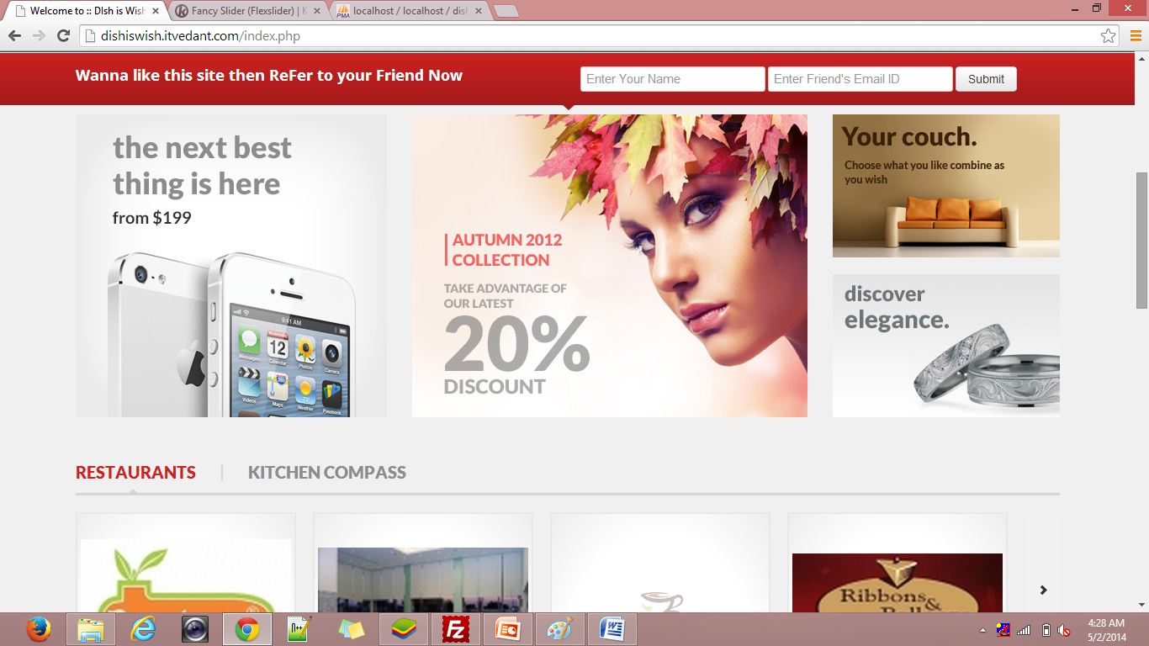
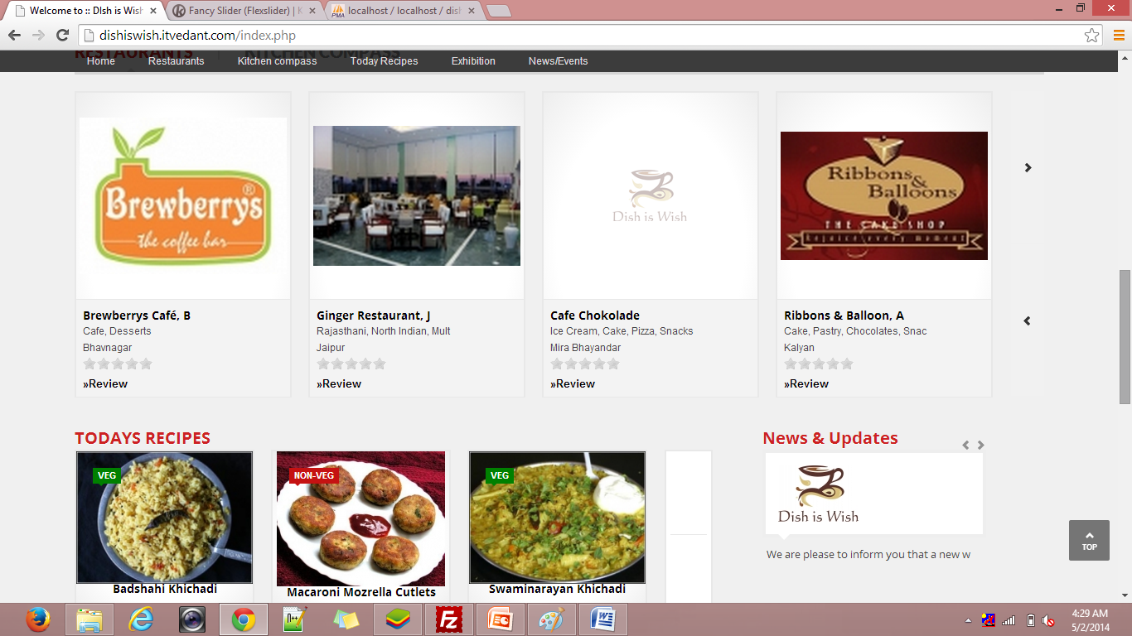
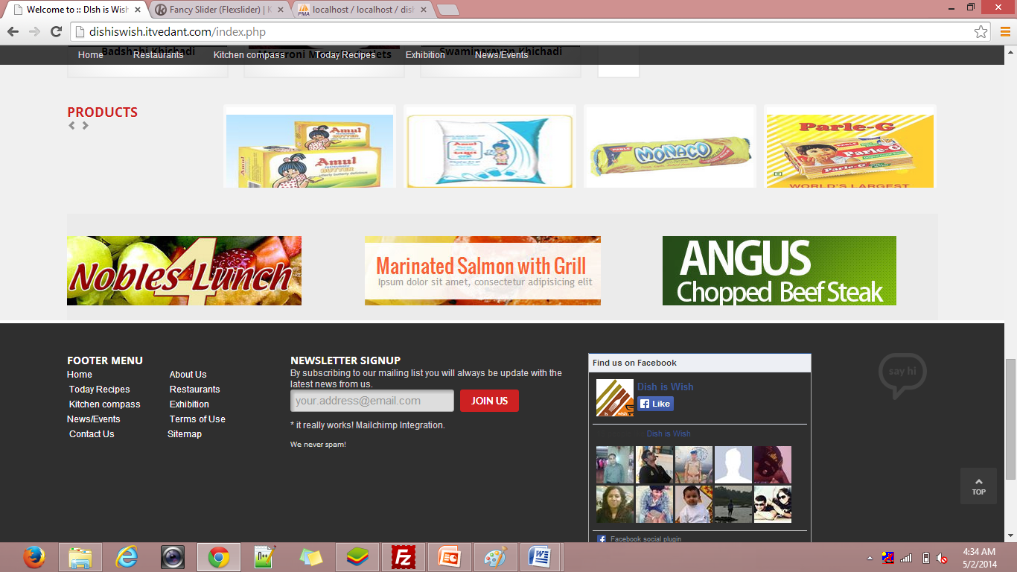
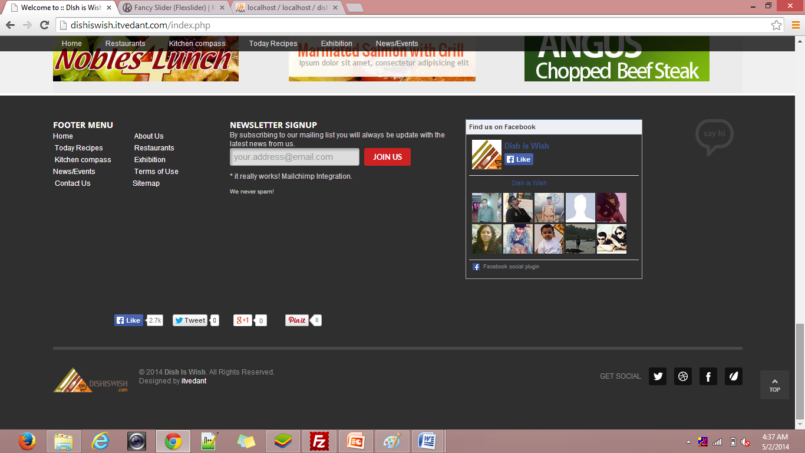
Index.php
INDEX

Slide 35
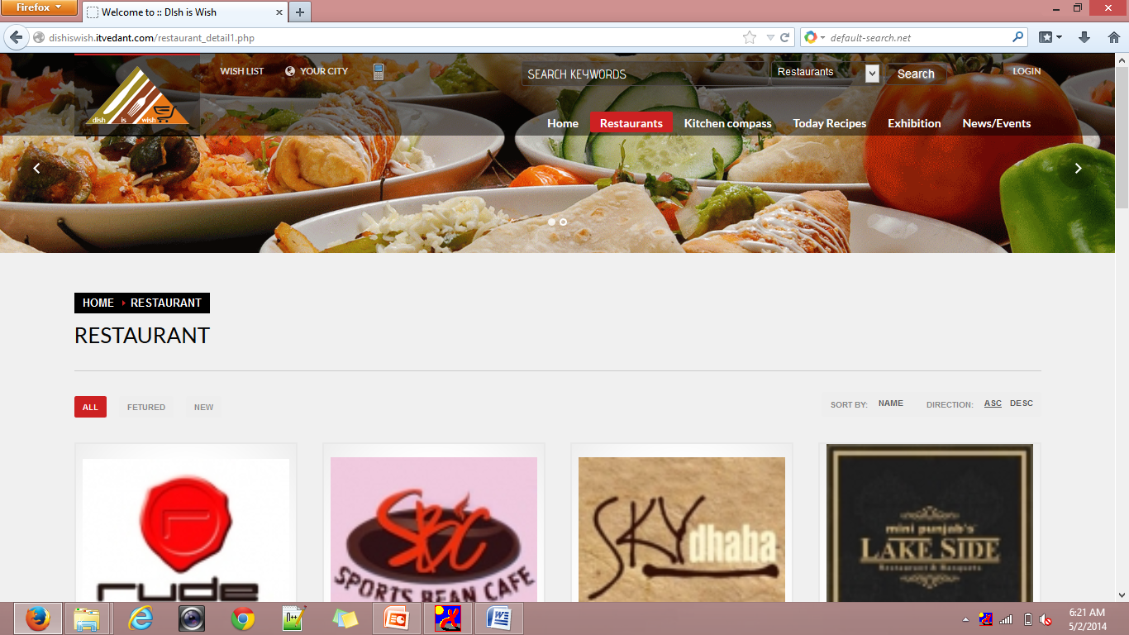
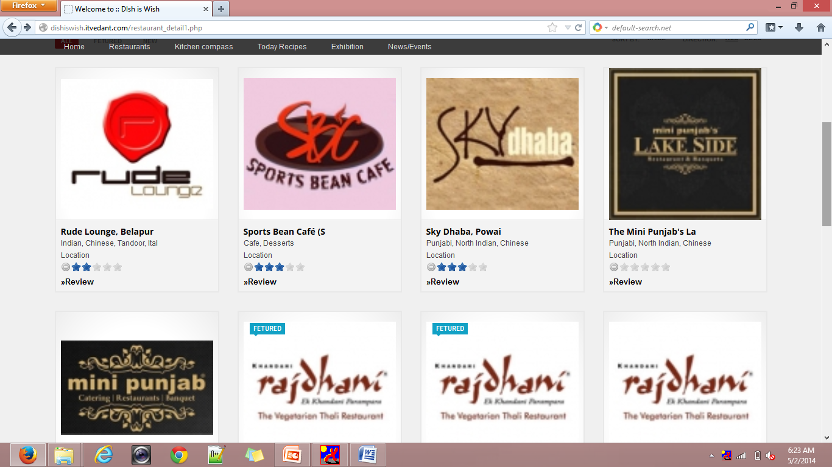
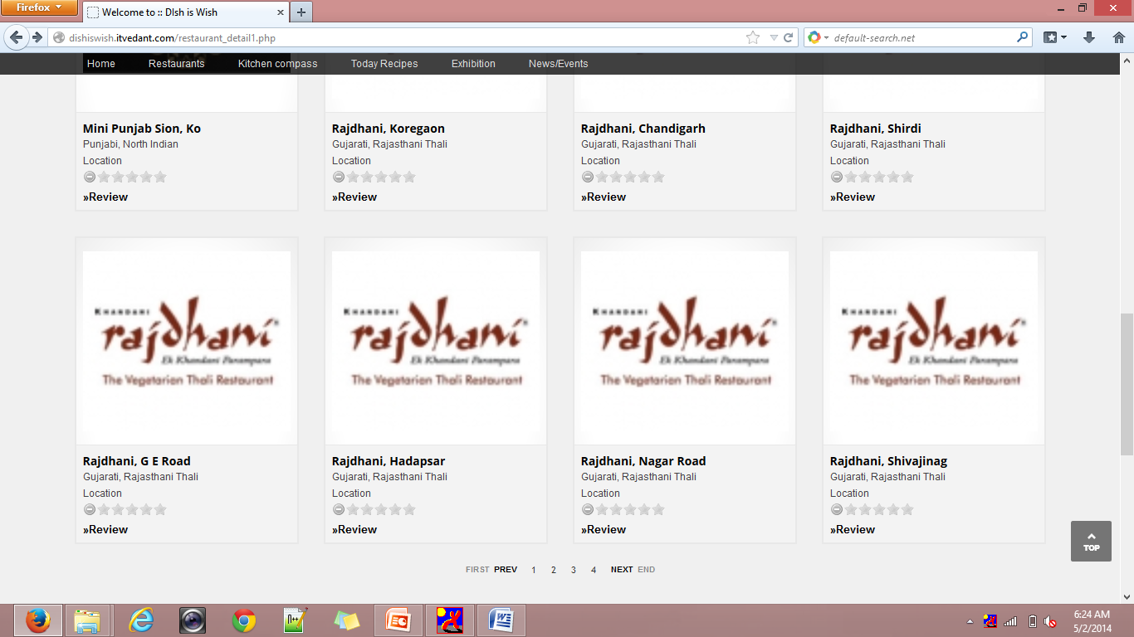
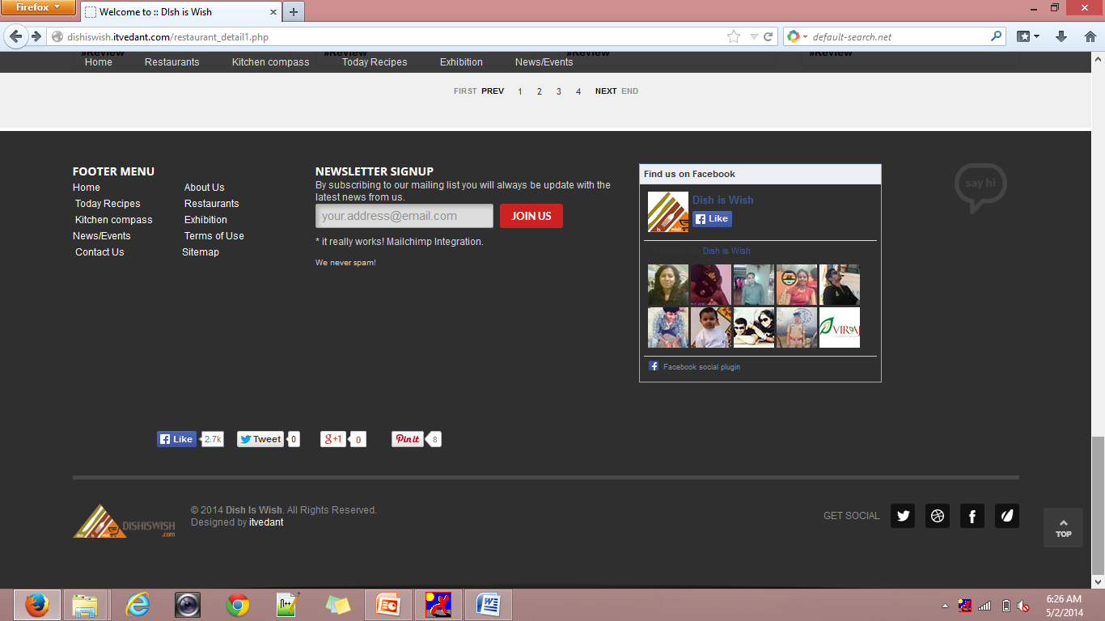
Restaurant_detail.php
INDEX

Slide 36
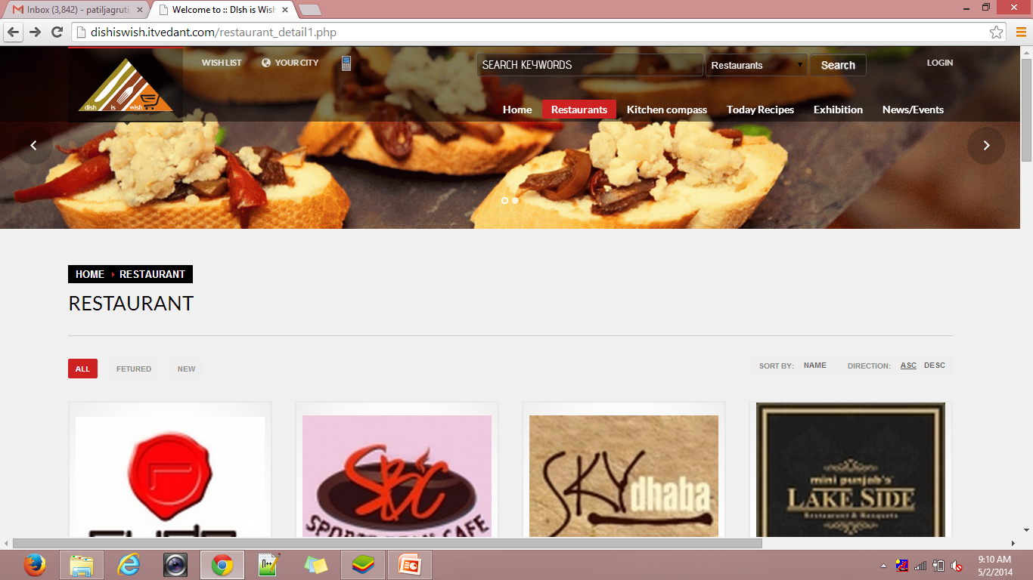
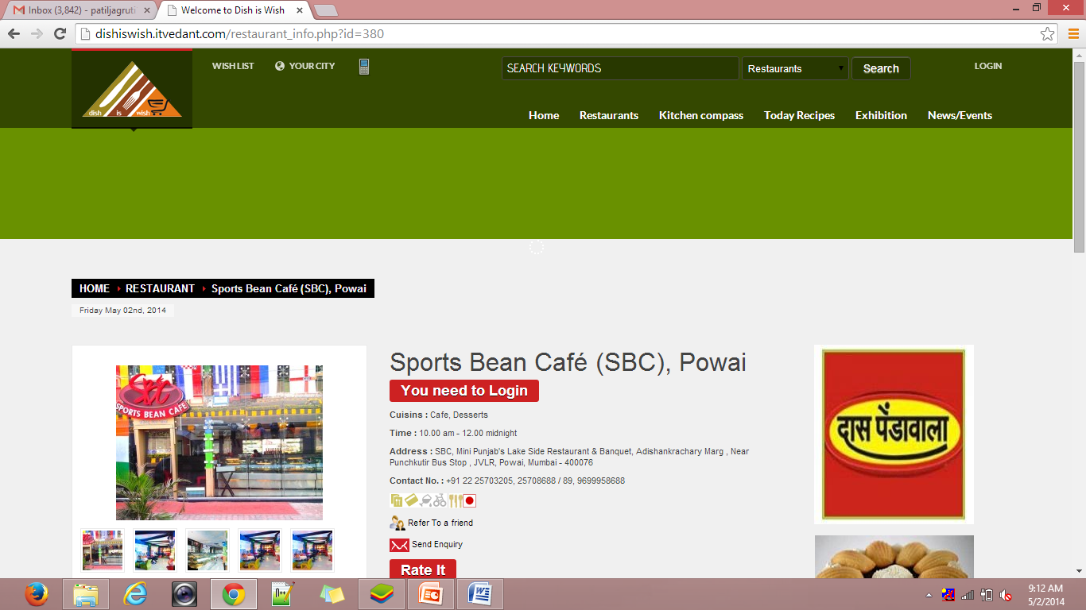
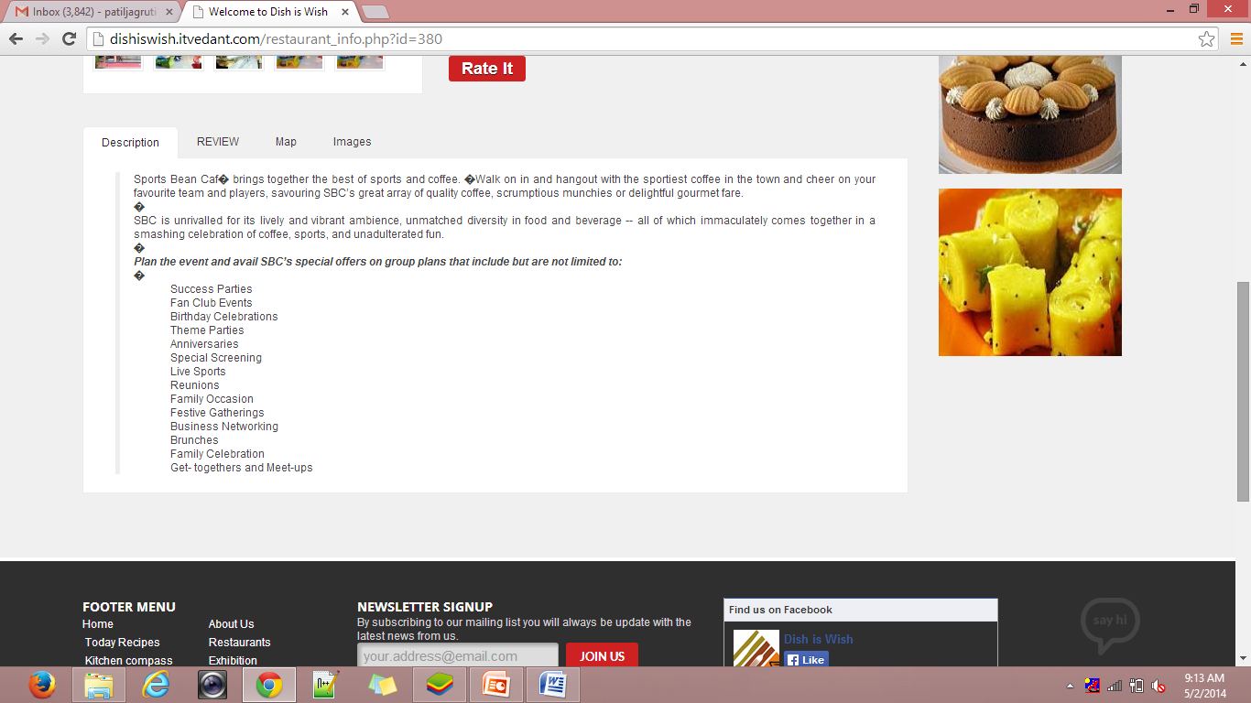
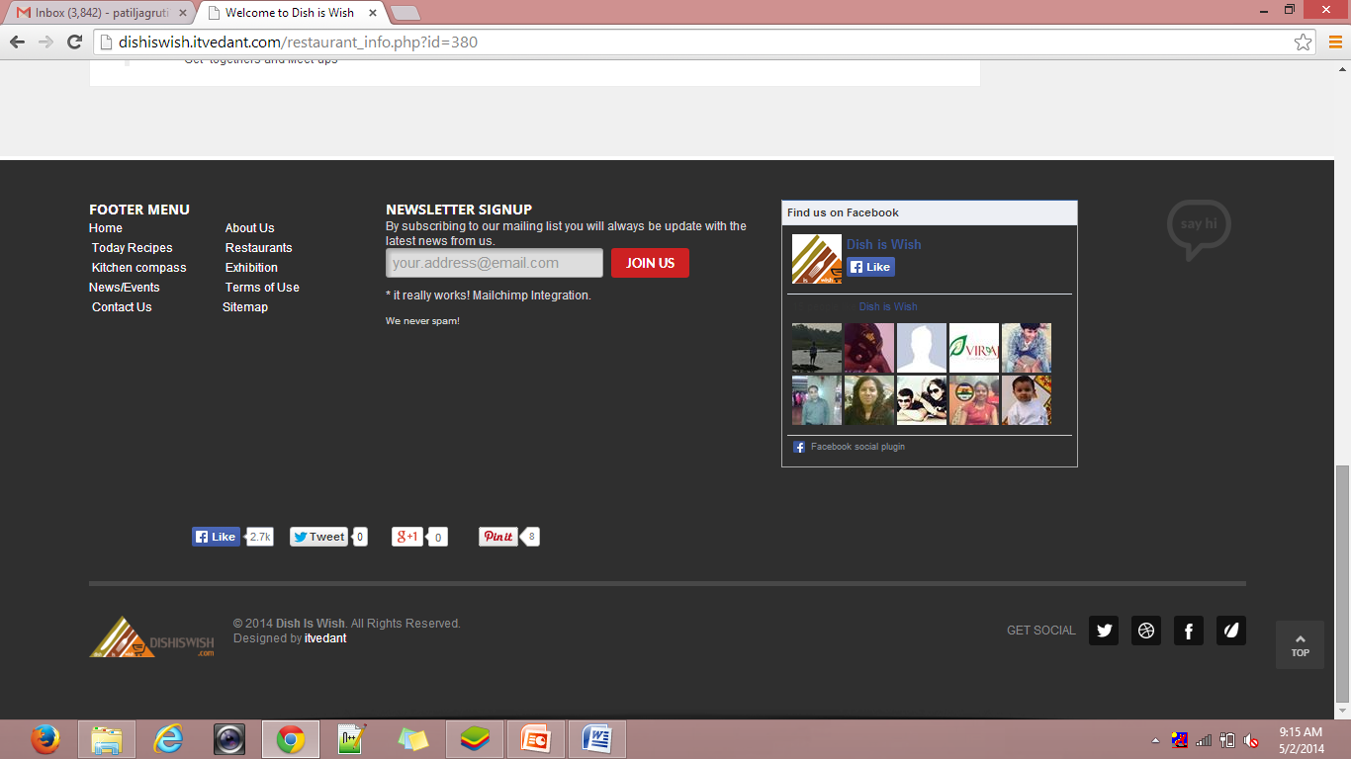
Restaurant_info.php
INDEX

Slide 37
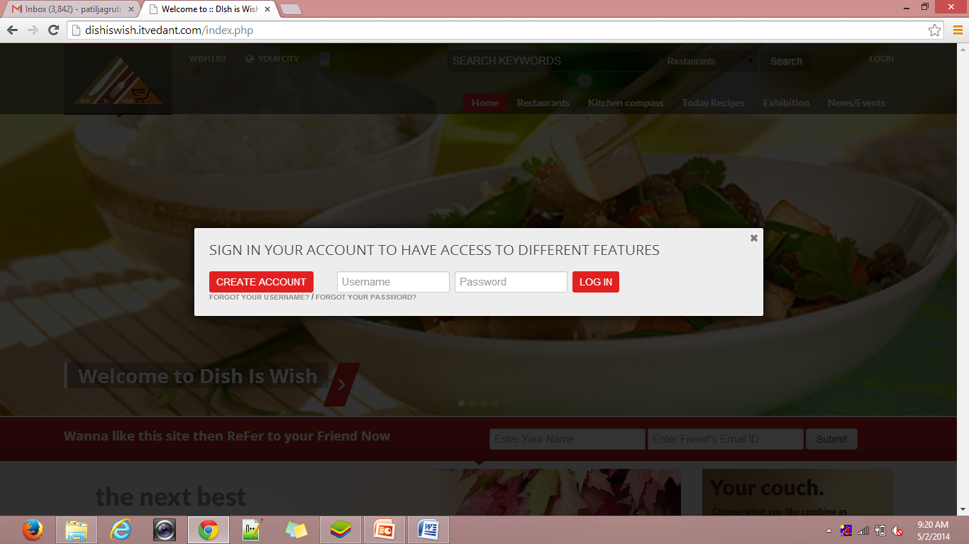
Login-panel
INDEX

Slide 38
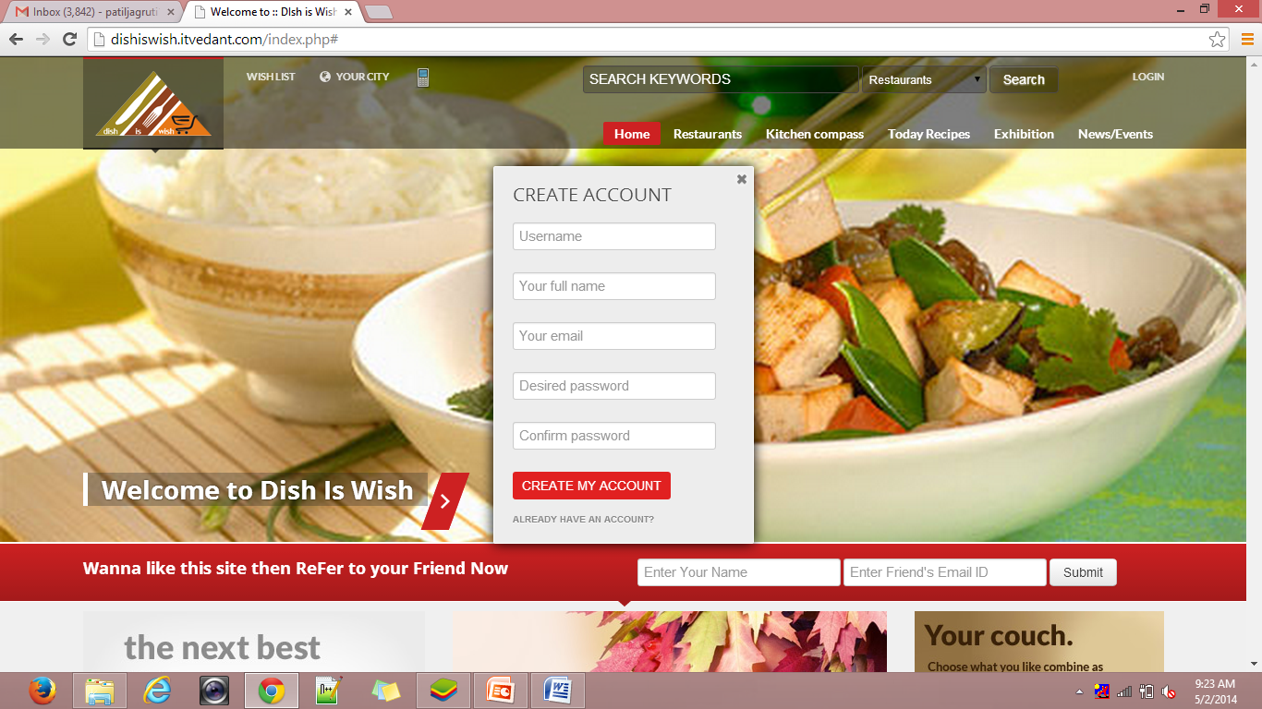
Register-panel
INDEX

Slide 39
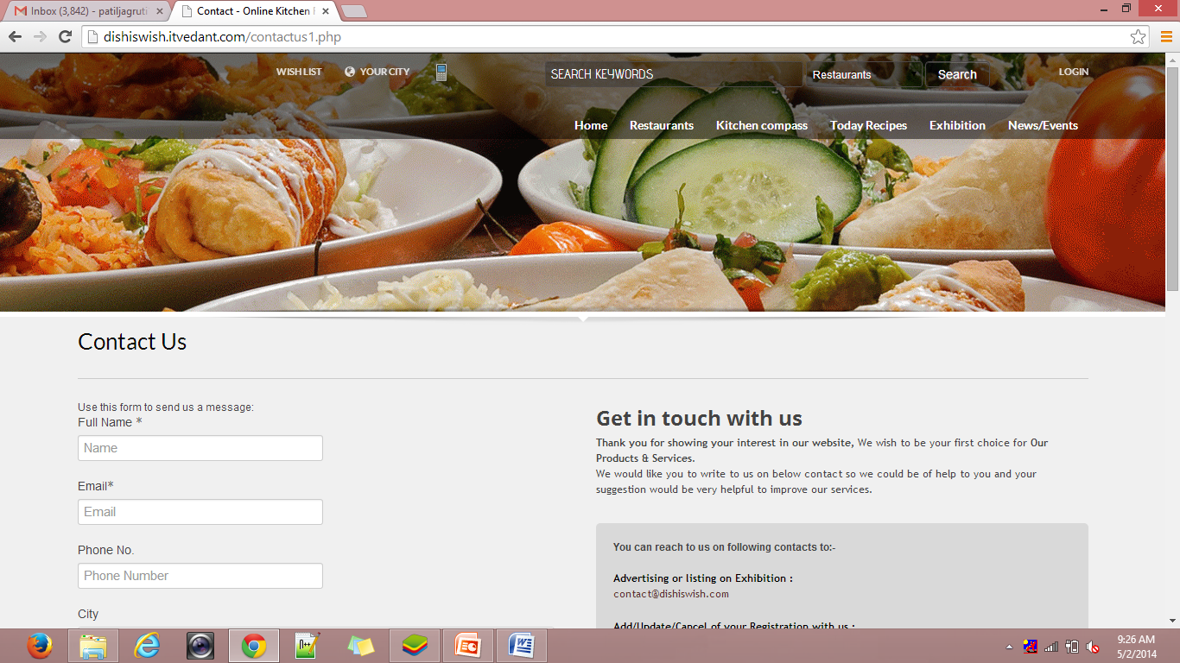
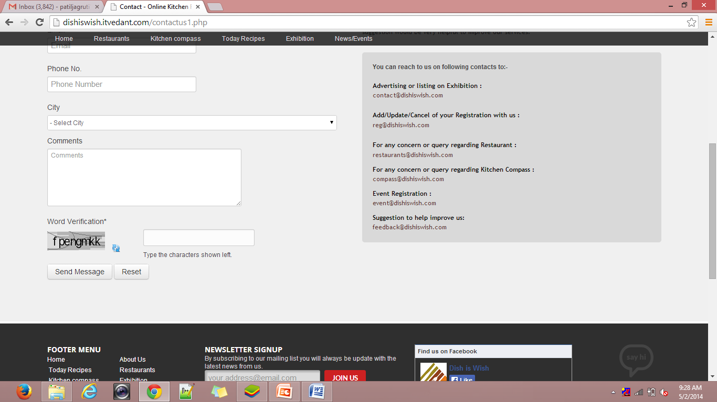
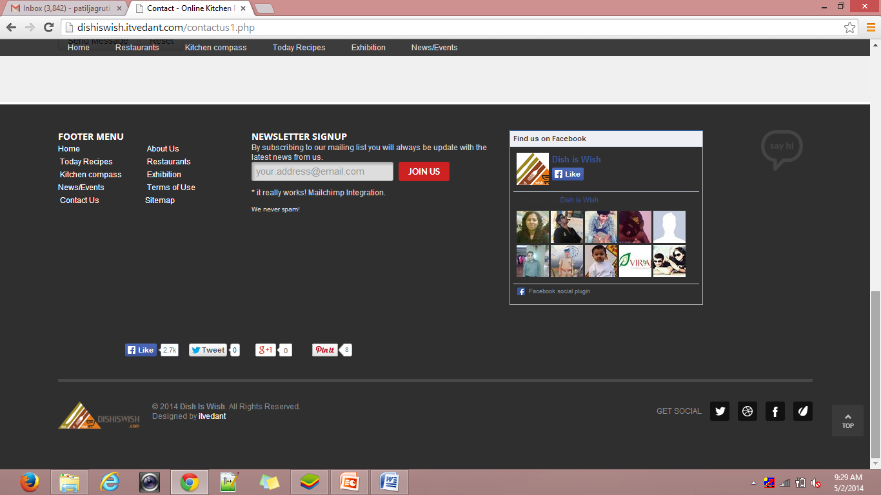
Contact_us.php
INDEX

Slide 40
SCREEN SHOTS
Admin
SCREEN SHOTS
OF
www.dishiswish.com
INDEX

Slide 41
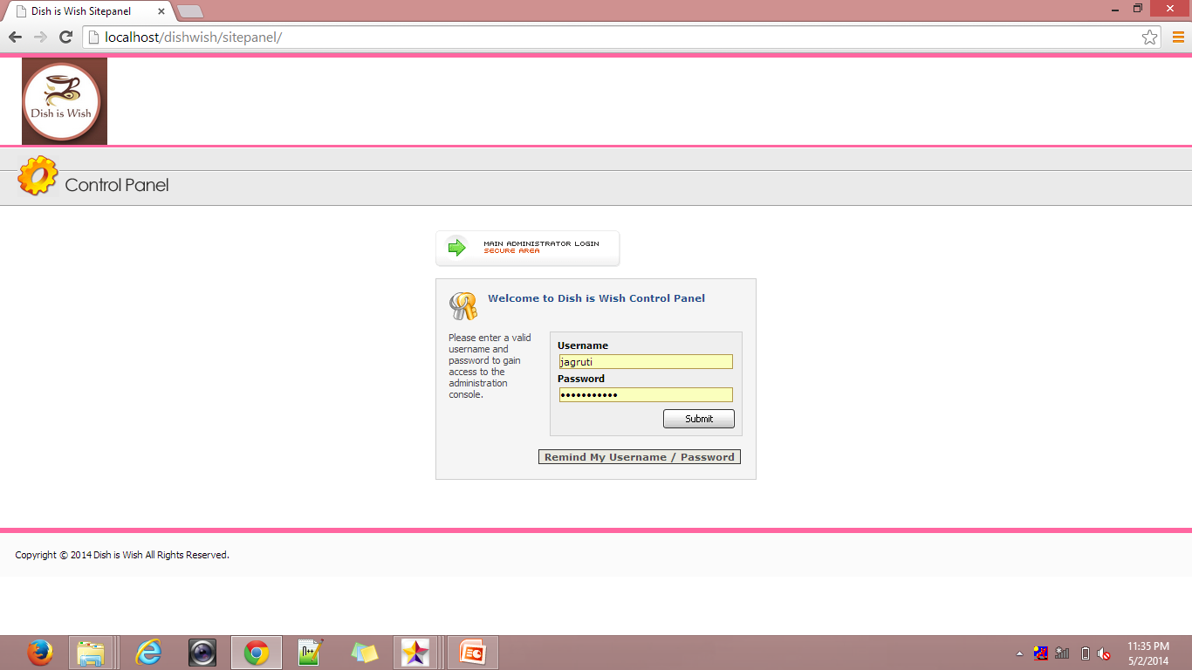
admin.php
INDEX

Slide 42
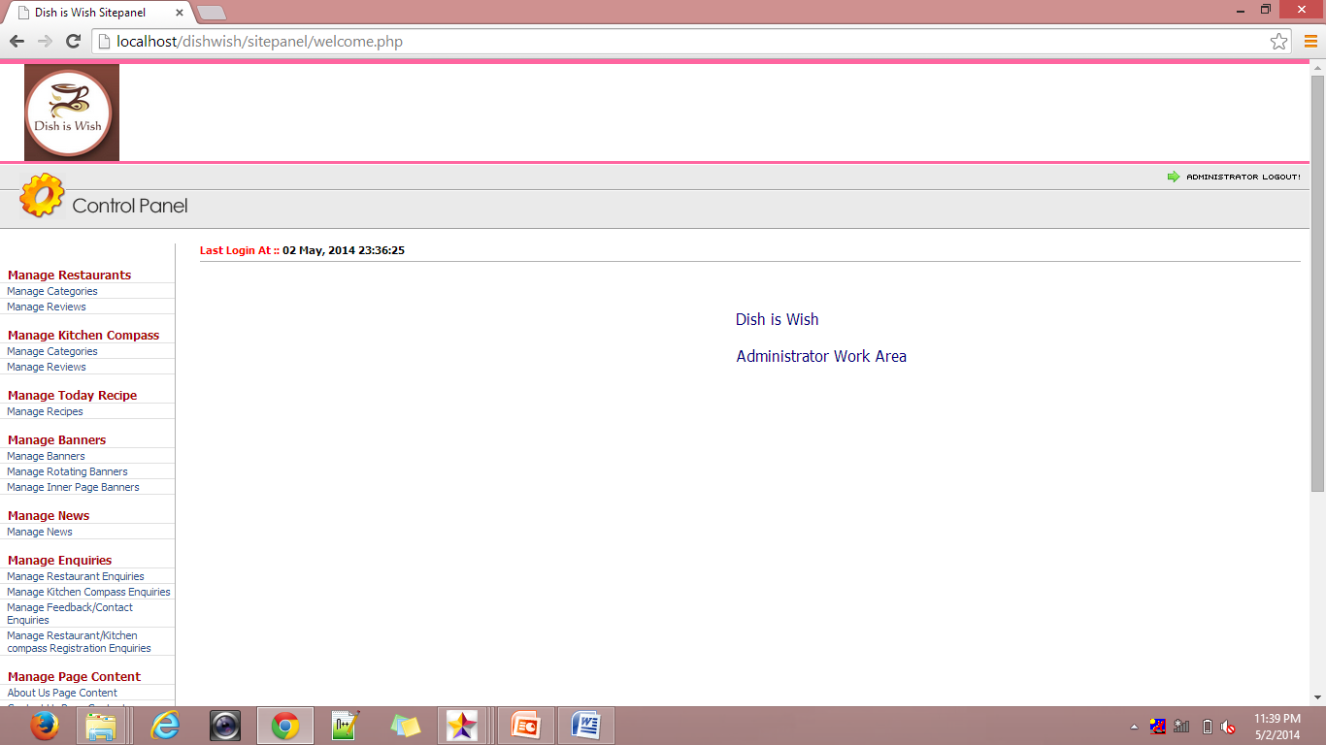
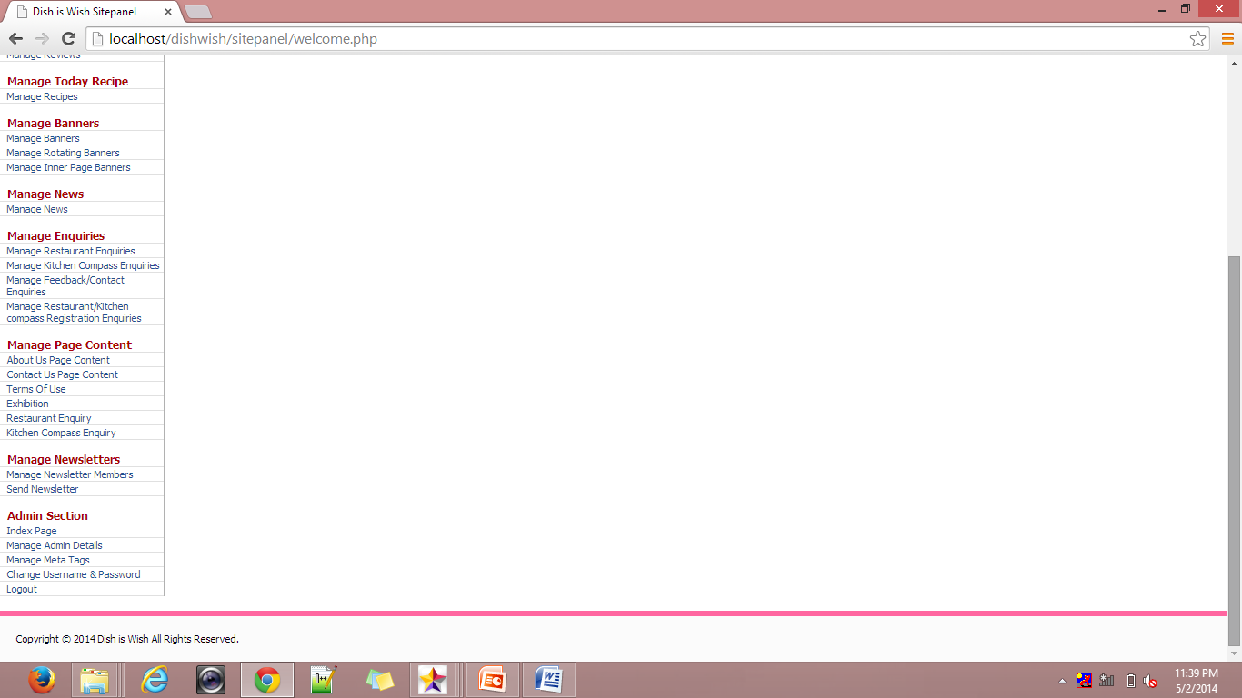
Welcome.php
INDEX

Slide 43
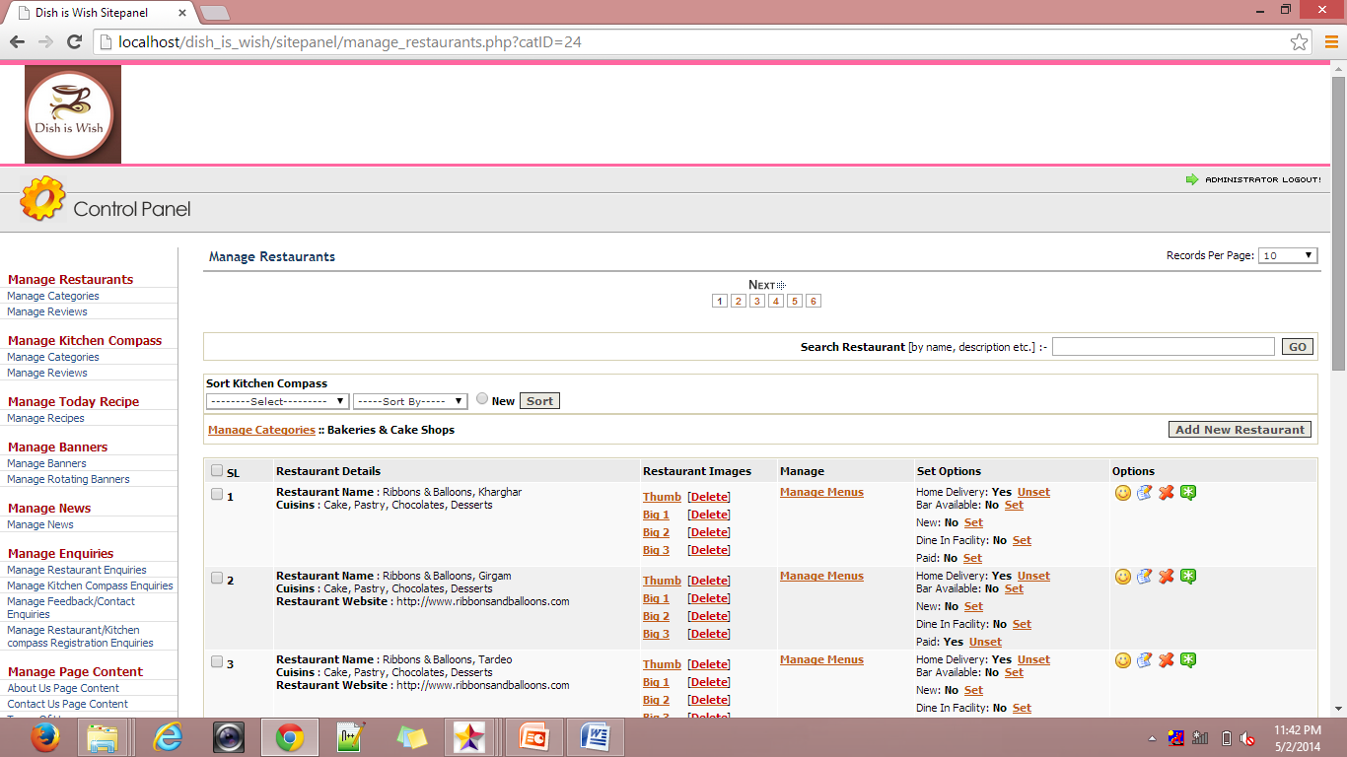
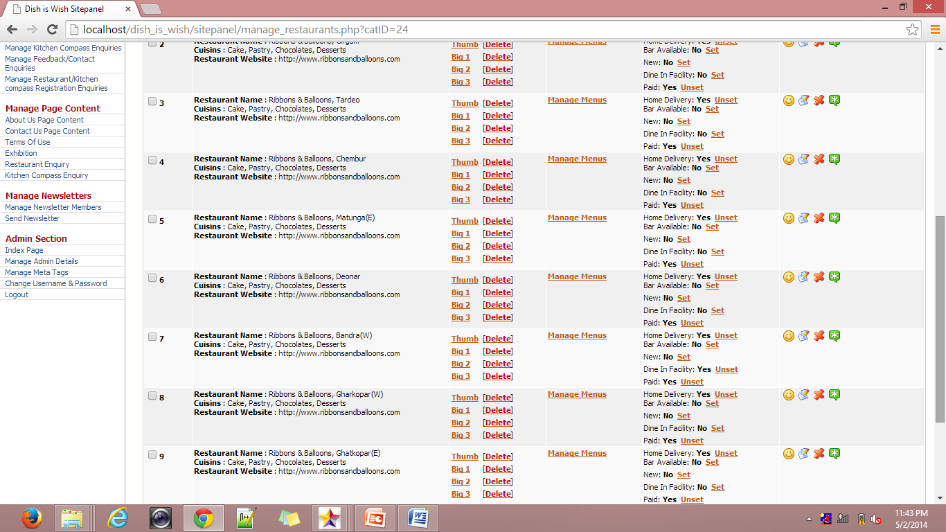
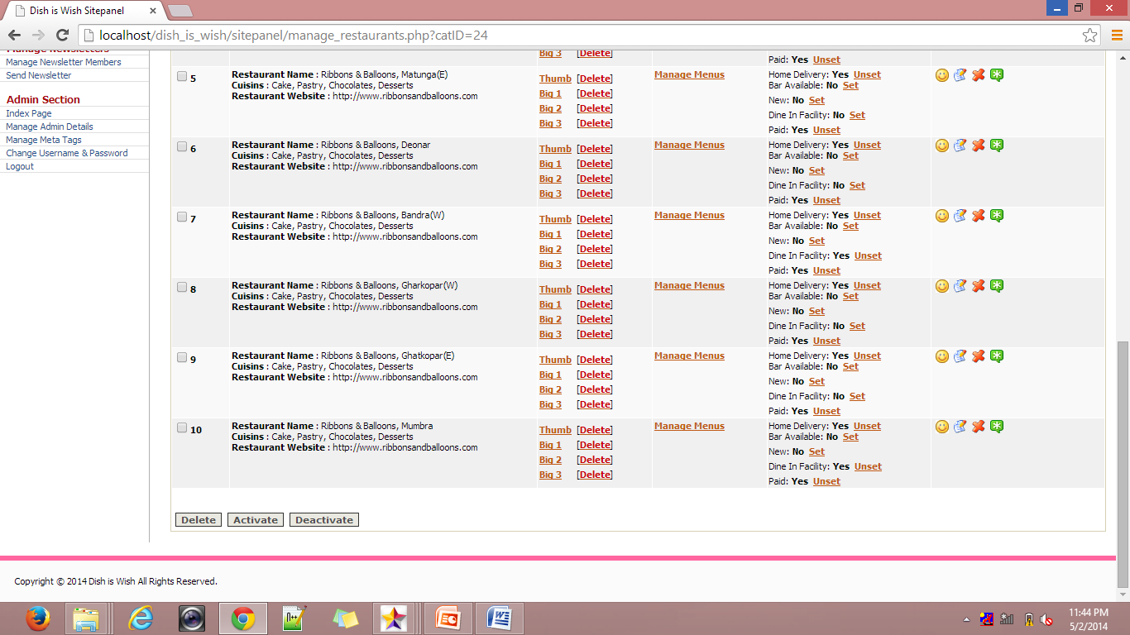
Restaurant.php
INDEX

Slide 44
BIBLIOGRAPHY
Websites:-
www.php.net
www.w3schools.com
www.stackoverflow.com
www.bootstrap.com
www.jquery.com
www.developers.facebook.com
44
www.dishiswish.com
INDEX
Notes:
Reference Books:-
PHP 5.1 for beginners.
Author: - Ivan Bayross and Sharanam Shah
Head First PHP and MYSQL
Author: - Lynn Beingley and Micheal Morrison.
Websites:-
www.php.net
www.w3schools.com
www.tizag.com
www.stackoverflow.com
www.bootstrap.com
www.jquery.com

Slide 45
Click to www.dishiswish.com
THANK
YOU!!!
INDEX

